Slide 1

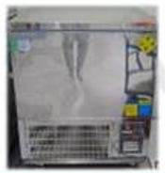
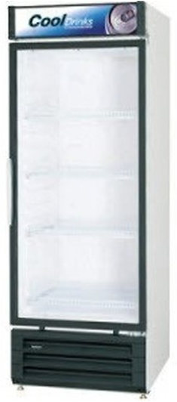
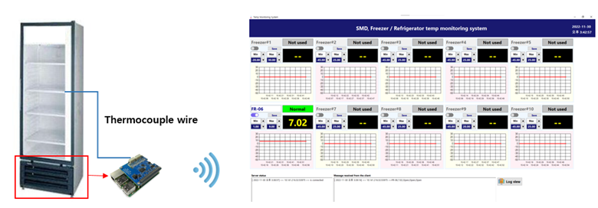
Weekly EED Activity – WW49
K5 / SMD
SMD / Underfill
New
SMD / EED
K5 SMD Freezer & Refrigerator temp monitoring system development
NA
NA
SMD requested to develop a system that can check the temperature of the freezer & refrigerator in real time
EE developed the wireless freezer temperature monitoring system for material management considering frequent lay-out
[Problem Description]
[Action Taken]
The freezer & refrigerator doesn't have the temperature monitoring system
Operator checked the temperature manually
Real-time temperature check
Temperature range alarm settings
Save temperature log (1min)
No monitoring system
Temp monitoring method : Visual check
Data transfer : No function
Temp monitoring method : Program monitoring
Data transfer : Wi-fi (5.0Ghz)
Cost save : $8.7K/1set (Outsourcing $10K vs. In-house $1.3K)
Enhancement on prevention against miss operation in manual process
HyunSu Park (SMD) / ww49 ’22 K5EE

